Slide 1



GHABA
A maze game solved by searching algorithms

Slide 2




FSOCIETY
TEAM
MOHAMED SAADY
SHARAF AHMED
HITHAM OMAR

Slide 3

TABLE OF CONTENTS
01
02
03
04
PROBLEM FORMULATION
AGENT SPECIFICATION
AI ALGORITHMS
PROJECT EXECUTION

Slide 4
01
PROBLEM
FORMULATION

Slide 5
PROBLEM DEFINITION
It’s a game where our player is spawned at a chosen start point and his goal is to reach the chosen end point.
Maze that has obstacles hinder the movement of player.
The player can only move in the dirt road, and can’t step on the grass.
Using AI algorithms, our player will know the path for the end point.

Slide 6
PROBLEM FORMULATION
START STATE
The player is at the chosen start point
SEARCH SPACE
All possible states reachable from the start except the obstacles
ACTIONS
Moving Up, Down, Left and Right
GOAL STATE
Reach the end
PATH COST
1 for each state

Slide 7
02
AGENT
SPECIFICATION

Slide 8
AGENT SPECIFICATION (PEAS)
Performance Measure
Environment
p
E
Actuators
SENSORS
A
S
Reach end
a grid randomly changed
Moving up, down, left and right
Select start and end and it’s a valid path

Slide 9
03
AI
ALGORITHMS

Slide 10
ALGORITHMS
DFS
BFS
UCS
A*
GREEDY

Slide 11
04
PROJECT
EXECUTION

Slide 12
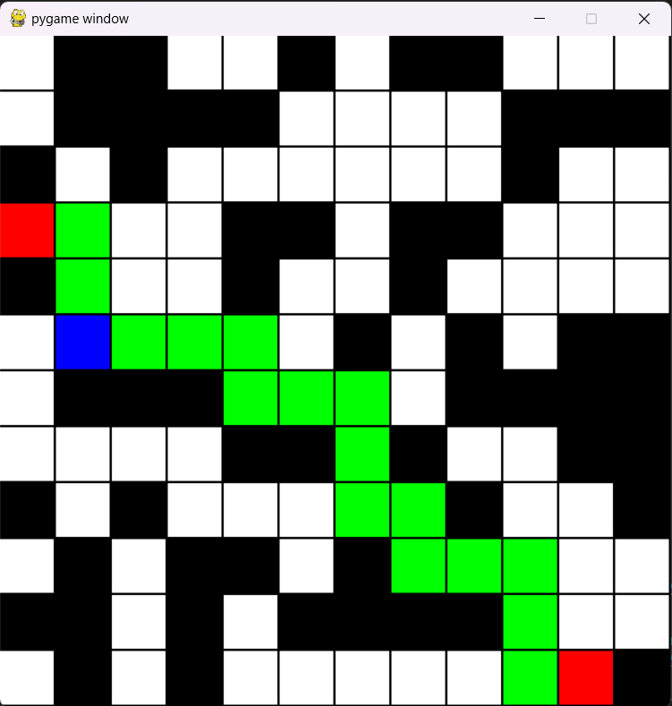
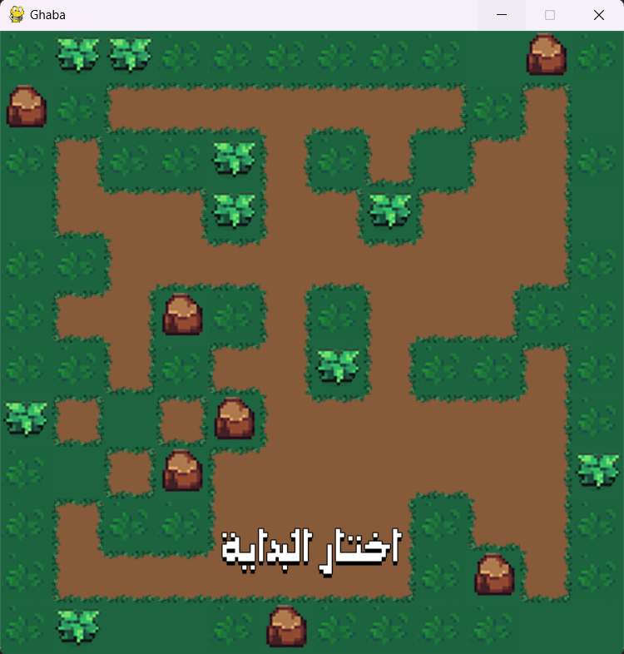

Slide 13
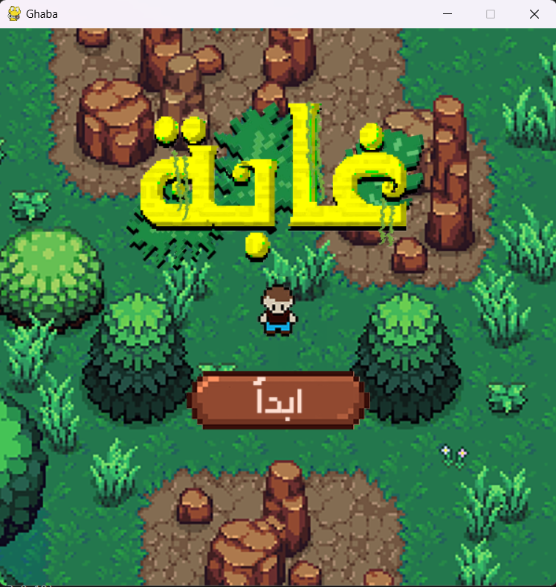
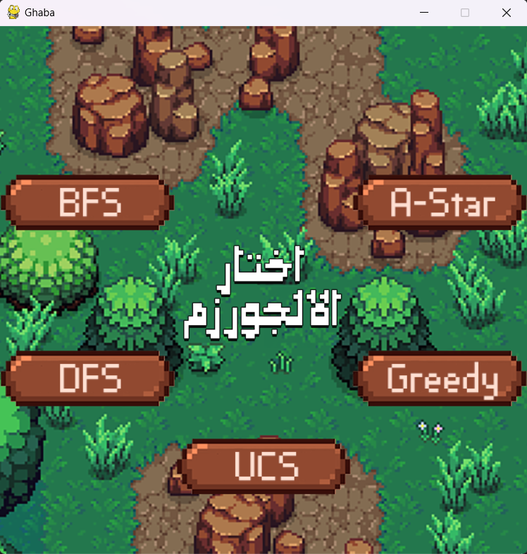

Slide 14
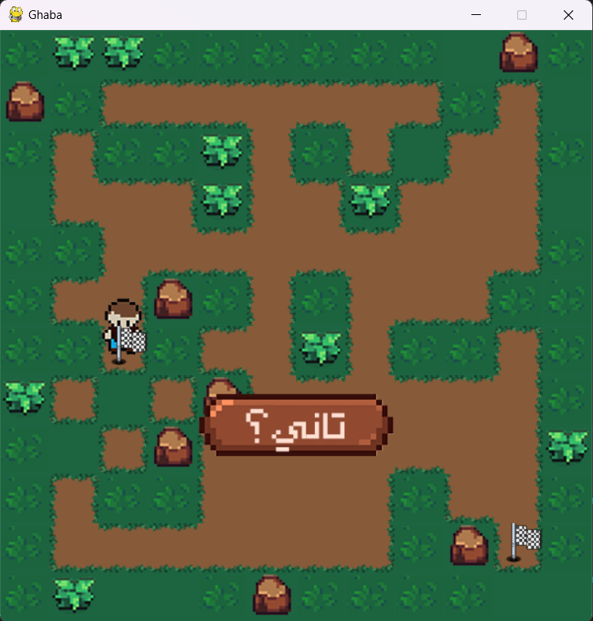

Slide 15
THANKS

